Slide 1




NetVRM: Virtual Register Memory for Programmable Networks
Hang Zhu
Tao Wang, Yi Hong, Dan R. K. Ports, Anirudh Sivaraman, Xin Jin

Slide 2
Data plane objects
Stateless (lifespan <= 1 packet)
Stateful (lifespan > 1 packet)
Metadata, packet headers
Tables, counters, meters, registers
Registers enable a new class of
reg-stateful applications
2

Slide 3



Registers in P4
Registers are stateful memories whose values can be read and written in actions.
m arrays
d estimators per array
c₁₁
$$h_{1}\left(k\right)$$
c₁₂
Counter: $C_{ij}+=c$
c₁₃
$$h_{m}\left(k\right)$$
c₁₄
Counter: return minimum
Count-Min Sketch
Implemented by registers in P4
3

Slide 4
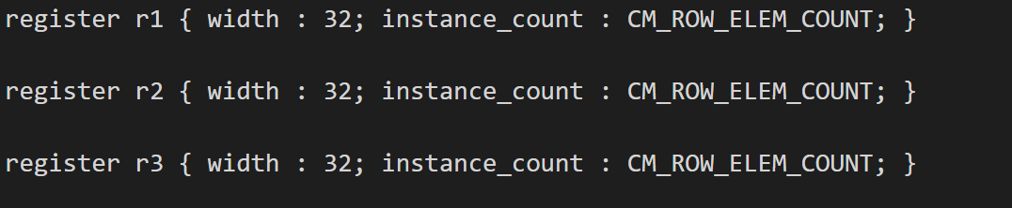
Registers in P4
Register memory is implemented with standard SRRM blocks.
Register can be read by both the control plane and data plane.

Slide 5
The case of dynamic allocation for register memory
Necessity
Limited register memory (e.g., a few Mb/stage)
Concurrent reg-stateful applications
Potential benefits
Most applications can operate with different amounts of available memory
Diminishing return
5

Slide 6
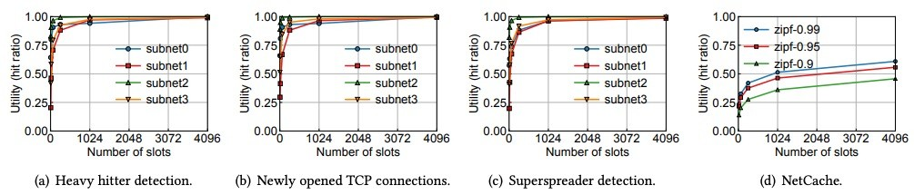
Diminishing return
Store flow records in the data plane.
Hash collisions caused by inadequate memory require additional control plane processing.
NetCache caches hot objects in the switch data plane
6

Slide 7
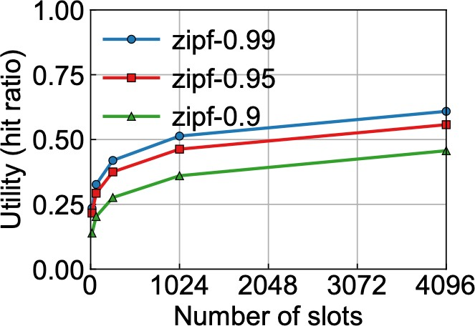
Diminishing return
NetCache with different skewed workload
Diminishing return: the benefit of additional memory decreases with the amount of allocated memory
0.28->0.36: 768 register slots
0.36->0.46: 3072 register slots
7

Slide 8
Existing solutions and limitations
Support multiple applications on a programmable switch
Static binding of register memory
Ignore hardware constraints
No network-wide dynamic allocation
Merged in compilation time
P4Visor [CoNEXT’18]
BMv2
Hyper4 [CoNEXT’16]
Allocation in a single switch
8

Slide 9
Realizing dynamic register memory allocation
How to enable online allocation
How to modify P4 programs
How to maximize multiplexing benefits
Virtual register memory
P4VRM compiler Dynamic allocation
9

Slide 10

NetVRM architecture
A network management system that supports dynamic register memory sharing between multiple concurrent applications on a programmable network
NetVRM
xx.p4vrm
Dynamic Memory Allocation
xx.p4vrm
App 1
App 2
App 3
Control Plane
Virtual Register Memory
P4VRM
Compiler
Run-time API
Data Plane
…
zoom in
Network
Develop and compile P4 programs with virtual register memory.
Dynamically allocate memory for multiple applications and try to satisfy as many application’s requirements as possible
Expose a virtual register memory abstraction to applications

Slide 11
Virtual register memory
Page tables
Counter record
App 1
App 2
App 3
App
Control Plane
Virtual Array
Virtual Register Memory
Page Table
Counter Record
NetVRM
Match | Action
app=1 | offset=0, size=16k
app=2 | offset=16k, size=16k
app=3 | offset=32k, size=32k
0
…
16k
…
32k
…
…
…
0
…
16k
…
32k
…
…
…
0
…
16k
…
32k
…
…
…
0
…
16k
…
32k
…
…
…
total_cnt
hit_cnt
total_cnt
hit_cnt
total_cnt
hit_cnt
…
…
Data Plane
Page Table
Multi-stage Physical Register Arrays
Counter Record
Parameters are configured by the control plane at runtime

Slide 12
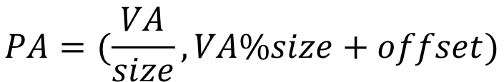
Address translation
0 1 2 3
0
1
2
3
4
5
6
7
0 | 2 | 4 |  | 6
1 | 3 | 5 |  | 7
Translation formula
$$PA=(\frac{VA}{size}, VA\%size+offset)$$
physical array index
physical slot index
size = 2, offset= 1 VA= 5 → PA= (2, 2)
VA=6 -> PA=(3,1)

Slide 13
Virtual register memory
Page tables
Counter record
App 1
App 2
App 3
App
Control Plane
Virtual Array
Virtual Register Memory
Page Table
Counter Record
NetVRM
The total number of packets for the application
Match | Action
app=1 | offset=0, size=16k
app=2 | offset=16k, size=16k
app=3 | offset=32k, size=32k
0
…
16k
…
32k
…
…
…
0
…
16k
…
32k
…
…
…
0
…
16k
…
32k
…
…
…
0
…
16k
…
32k
…
…
…
total_cnt
hit_cnt
total_cnt
hit_cnt
total_cnt
hit_cnt
…
…
Data Plane
The number of packets that hits the switch register memory
Page Table
Multi-stage Physical Register Arrays
Counter Record
Real time hit ratios
Parameters are configured by the control plane at runtime

Slide 14
NetVRM architecture
NetVRM
xx.p4vrm
Dynamic Memory Allocation
xx.p4vrm
App 1
App 2
App 3
Control Plane
Virtual Register Memory
P4VRM
Compiler
Run-time API
Data Plane
…
zoom in
Network
Dynamically allocate memory for multiple applications and try to satisfy as many application’s requirements as possible

Slide 15
Scope of dynamic resource allocation
Elastic applications Inelastic applications
Work with a variable amount of register memory
Overcome insufficient register memory with a fallback mechanism
Require a fixed amount of register memory
Cannot work with less
benefit
support

Slide 16
Dynamic resource allocation
Elastic applications Inelastic applications
Polls the counter from the data plane
Obtains the utility
Dynamically allocates the register memory for each application based on utility
benefit

Slide 17
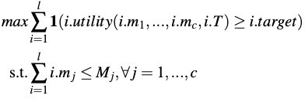
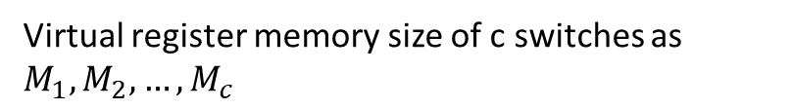
Problem formulation
Objective
Maximize number of applications with satisfied utility target
Constraints
Register memory constraints on each switch
Virtual register memory size of c switches as $M_{1},M_{2},…,M_{c}$

Slide 18
Challenges for dynamic resource allocation
Definition of application utility
Unknown and dynamic utility functions
Multiple paths of an application
Memory hit ratio by default

Slide 19


Memory hit ratio by default
m packets processed
n packets
by register memory
n-m packets
Application-agnostic
Reflect application-level performance
Fallback mechanism
Computed online
Hit ratio = $\frac{m}{n}$

Slide 20











Challenges for dynamic resource allocation
Unknown and dynamic utility functions
Online utility curve estimation

Slide 21
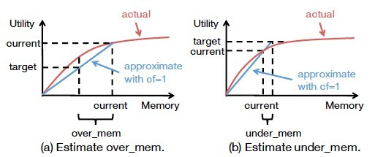


Online utility curve estimation
The amount of memory that can be moved
The amount of memory to be added
cf>1: compensate for the diminishing return

Slide 22






Dynamic resource allocation
Step 1: decompose over_mem and under_mem
Step 2: over_mem -> under_mem
Multiple paths of an application
Network-wide register memory allocation
At the end of each allocation epoch, NetVRM fetches counters, computes the online utilities, and then make the new memory allocation plan.

Slide 23
NetVRM architecture
NetVRM
xx.p4vrm
Dynamic Memory Allocation
xx.p4vrm
App 1
App 2
App 3
Control Plane
Virtual Register Memory
P4VRM
Compiler
Run-time API
Data Plane
…
zoom in
Network
Develop and compile P4 programs with virtual register memory.

Slide 24

P4VRM compiler
Step 1: developers extend .p4 to .p4vrm
developers
Mark the register arrays and related
heavy_hitter
.p4
heavy_hitter
.p4vrm
.p4 with VRM
p4vrm compiler
.cpp for
updates
declarations as virtualized
netcache
.p4
netcache
.p4vrm
…
…

Slide 25
P4VRM compiler
Step 1: developers extend .p4 to .p4vrm
developers
Step 2: compiler outputs .p4 and .cpp
.p4 with VRM
heavy_hitter
.p4
heavy_hitter
.p4vrm
p4vrm compiler
netcache
.p4
netcache
.p4vrm
.cpp for updates
…
…
Control plane APIs for resetting counters, fetching counters, resetting memory and configuring the virtual memory

Slide 26
Implementation
6.5 Tbps Intel Tofino switch
Four emulated switches with four independent pipelines
P4VRM compiler
built on Flex/Bison (tools for building compilers)

Slide 27
Evaluation
Microbenchmark
Control loop delay
Stability and fast convergence of NetVRM
Macrobenchmark
Generality
Impact of allocation epochs
Impact of workload parameters
NetVRM in datacenter network

Slide 28
Evaluation
Microbenchmark
Control loop delay
Stability and fast convergence of NetVRM
Macrobenchmark
Generality
Impact of allocation epochs
Impact of workload parameters
NetVRM in datacenter network

Slide 29
Control loop delay
Fetch Calc
Reconfig Runtime
Runtime: the runtime overhead for resetting the state (e.g., counters)
15
Delay (ms)
10
One reallocation can be done in ~10 ms
Reconfig dominates the control loop
5
0
32 64 128 256
Number of concurrent applications
The time to complete a virtual memory reallocation.

Slide 30
Macrobenchmark
NetVRM configuration and network topology
Allocation epoch and measurement epoch are one second
Each application has traffic from 4 switches independently
NetVRM applications
Heavy hitter detection (HH)
Newly opened TCP connection detection (NO)
Superspreader detection (SS)
Sources that connect to a large number of distinct destinations
Sketch-based heavy hitter detection (SHH)
Traces
2019 passive CAIDA traces
Alternative approaches
Equal-All: statically assigns an equal amount of register memory to all applications
Equal-Active: equally assigns register memory to active instances

Slide 31
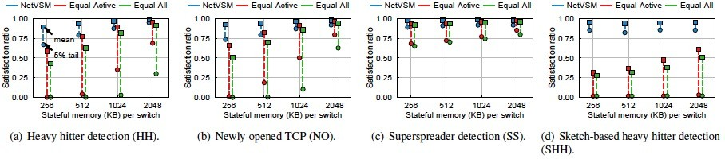
Generality
Each application has traffic from four switches independently
Satisfaction ratio as the performance metric
Alternatives: Equal-All, Equal-Active
NetVRM outperforms alternatives on both the mean and the tail
NetVRM is general to different network application types

Slide 32
Impact of allocation epochs
Mean
5% tail
Drop ratio
Reject ratio
1.0
0.8
0.6
0.4
0.2
0
2
4 8
Allocation epoch (s)
16
A shorter allocation epoch leads to a better performance

Slide 33
Conclusion
NetVRM supports dynamic register memory sharing between multiple concurrent applications on a programmable network
Virtual register memory: enable online register memory sharing
Dynamically allocate memory for better resource efficiency
P4VRM: easily equip the programs with virtual register memory

Slide 34
Thank you!

